Slide 1
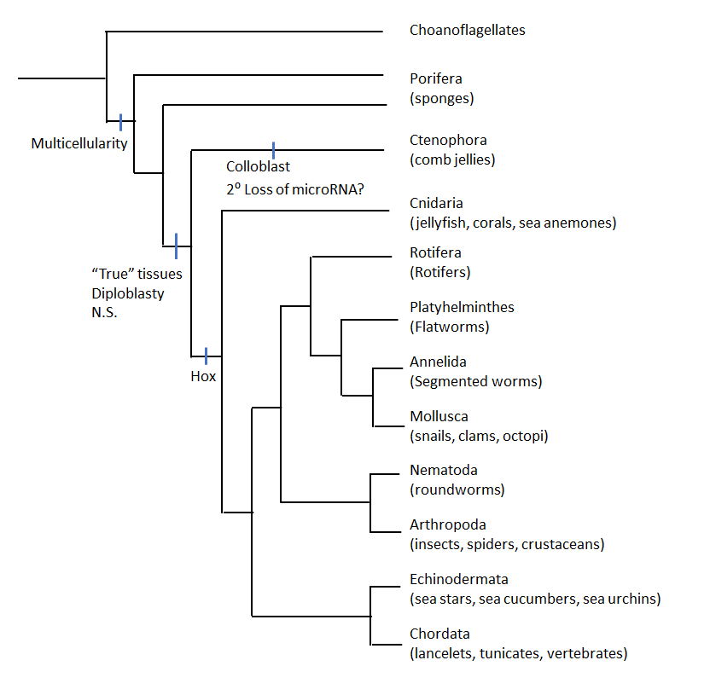
Animal Systems I
Notes:
Welcome to your first round learning about animal systems! As you can see from this image we move from more simplistic to complex animals as we shift towards the right. Most animals are separated via phyla based on characteristics such as tissue types, symmetry, presence or absence of coelom, exo versus endo skeleton, segmentation and the presence or absence of a vertebrate. In lecture you will have already seen much of this information and for the purposes of lab we are going to start to look more at the differences in the various systems of some of these animals. The main systems we will be looking at are the circulatory, respiratory, excretory, digestion and reproduction. For the next two labs we are going to look at three phyla; Annelida, Mollusca and Arthropoda. You will have an opportunity to not only see some representatives in lab but do some dissections but first we have to start with some background. So let’s get started!

Slide 2
Getting To Know Annelids!
Notes:
Hello Annelida! This is also referred to as the segmented worm. This group is characterized by the presence of a body cavity (coelom), setae and body segments. There are so many different representatives here but of course the one we think of most often is of course those earthworms that we depend on to decompose organic matter and thus are major contributors to recycling nutrients back into the soil. Just wait till you get to open one up and see all the soil in the digestive system! Annelids are found in just about all types of habitats and can vary in length from less than an inch to 20 feet.

Slide 3
Phylum Annelida: Digestion
Coelom – Temporary Nutrient Storage & Excretion
”One Way” Digestive Tract
Mouth to Anus and Everything in Between
Notes:
There is a huge variation in the diet and feeding of this phyla but for the purposes of this lab we are going to focus on our oligochaete friend the earthworm. These guys are scavengers eating mostly dead plant material. Some will also feed on algae and microscopic animals. These guys have a one way digestive system. In through the mouth and out to through the anus. They have a coelom which contains coelomic fluid where many metabolic process can be found and which acts as a temporary nutrient storage location and excretion of wastes. The digestive system is essentially a straight tube with a mouth – esophagus – intestine – anus. Some annelids do have proboscis which can be thrusted forward. In our earthworm friend the mouth opens into a muscular pharynx, which leads to the esophagus, then the gizzard and finally into the intestine. You should be able to see these structures in your dissected earthworm and of course in the videos on Canvas.

Slide 4
Phylum Annelida – Respiration
With the help of my respiratory pigment HEMOGLOBIN
Notes:
Breathing for earthworms takes place across the skin rather than through the lungs like us. Oxygen is carried in the blood by a respiratory pigment called hemoglobin similar to that in humans. In other annelids this pigment may vary depending on the habitat of the annelid.

Slide 5
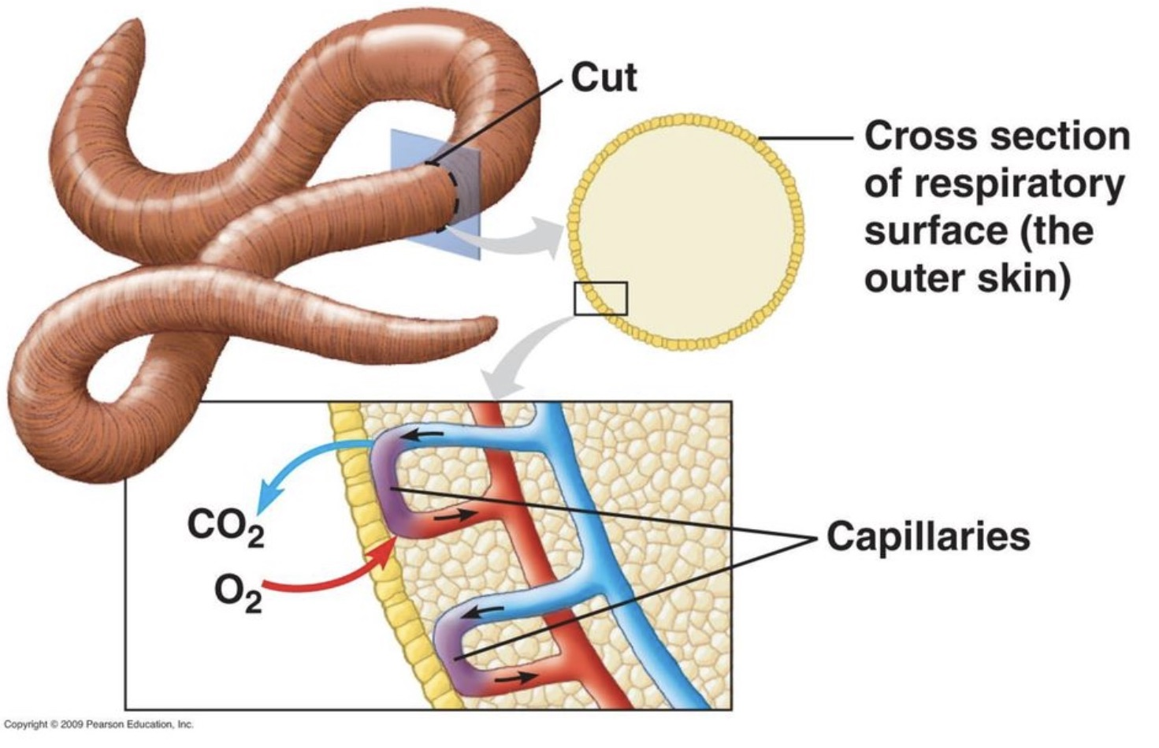
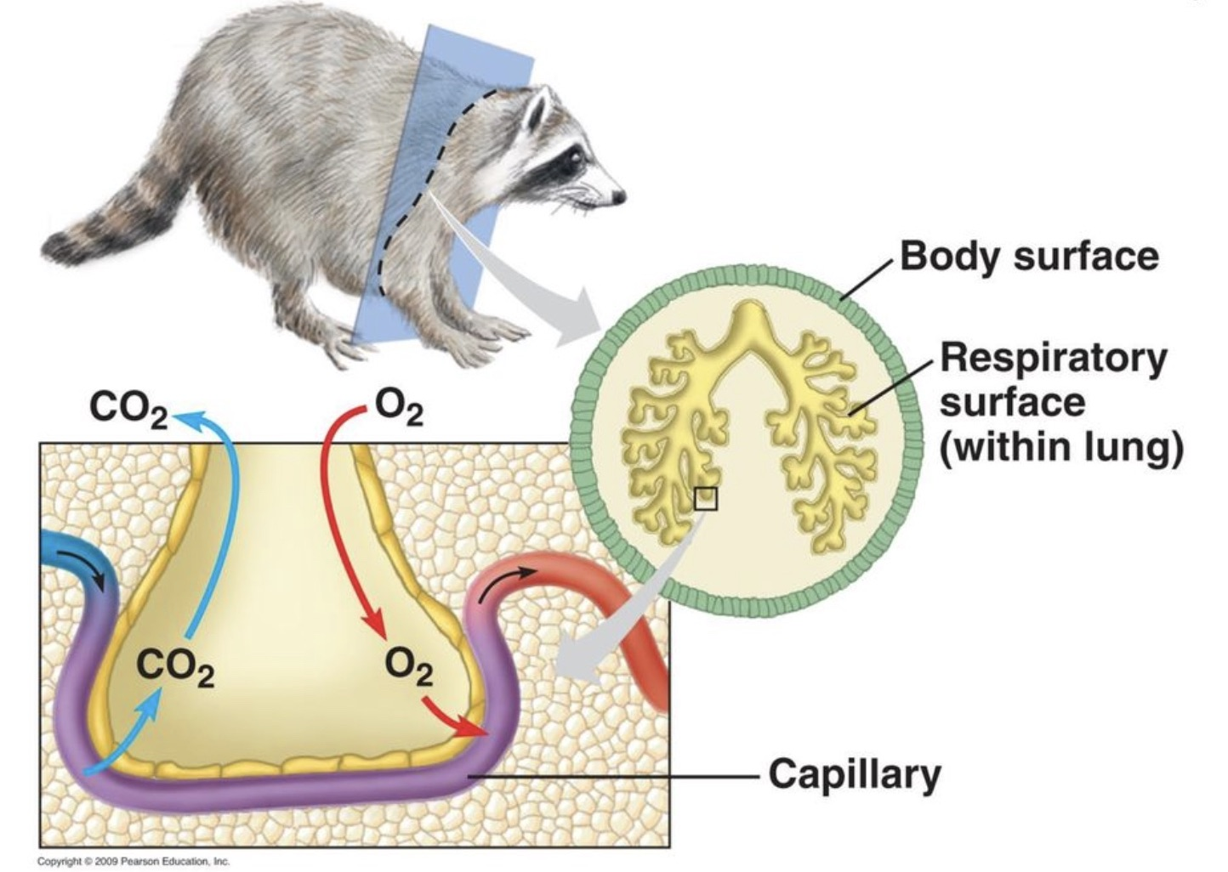
Phylum Annelida: Respiration
Notes:
Here you can see a bit closer the respiration via simple diffusion between the skin and the outside world in our earthworms compared to a mammal such as the racoon example here. In mammals we see diffusion across the respitory surface within the lung rather than directly to the outside. So essentially the skin of the earthworm is the respiratory organ compared to say the lung being the respiratory organ of us and other mammals. A key to all respiratory structures is that they must be relatively thin with few cell layers.

Slide 6
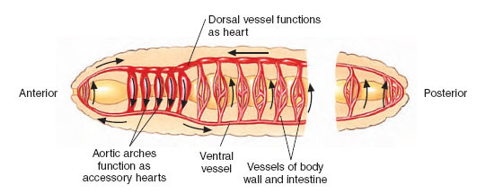
Phylum Annelida: Respiration and Circulation
Dorsal Vessel - Anterior
Closed Circulatory System
Ventral Vessel - Posterior
Exchange Occurs at Capillaries
http://zoology2014rylee.weebly.com/annalida-earthworm.html
Notes:
Okay so how does respiration occur via the skin? Our earthworm friend has 5 pairs of aortic arches or “hearts” which will pump blood from the dorsal (top) vessels to the ventral (bottom). The dorsal blood vessel moves blood anteriorly (towards the head) while the ventral vessels move blood posteriorly (towards the back). The aortic arches will be easy to see in your dissection but if you want a challenge be really careful when opening up your worm and you might find the dorsal blood vessel along the dorsal side of your worm (so it will be under all the stuff you are looking at). Exchange between blood and interstitial fluid occurs via diffusion at the capillary beds. Circulation in the earthworm is thus a closed system

Slide 7
Phylum Annelida: Closed Circulation
Notes:
Here you can see our earthworm and its closed circulatory system compared to the open circulatory system of the grasshopper. We will discuss the details of the grasshopper respiratory system in a bit but as you can see the blood of the earthworm remains within the vessels and is not released into the surrounding interstitial fluid while in the grasshopper the heart pumps the hemolymph into the open cavity.

Slide 8
Phylum Annelida: Excretion and Osmoregulation
In through nephrostome and out through the nephridiopore
Coelomic fluid enters through the metanephridium via a nephrostome
Protonephridia or Metanephridia?
Depends on the Annelid!
Dilute urine is excreted via the nephridiopore
https://www2.estrellamountain.edu/faculty/farabee/biobk/BioBookEXCRET.html
Notes:
Okay lets talk excretion and osmoregulation! In the annelid excretory system we have either protoneprhridia or metanephridia that open to the outside for excretion. Protonephridia are basically a network of dead-end tubules with no internal opening while the metaneprhridia are an excretory gland with cilia covered funnels opening into the body cavity/coelom. In the case of our familiar earthworm we have metanephridia as an excretory organ. Here the waste from the body cavity enters the Nephrostome, which looks like a ciliated funnel, and sends it out via the Nephridiopores. The metanephridia (the whole apparatus) can be found at every segment started at segment 15 and on.

Slide 9
Phylum Annelida: Earthworm Reproduction
https://www.naturewatch.ca/wormwatch/how-to-guide/ecology-reproduction/
Notes:
Annelids are hermaphroditic meaning they are both male and female however they still require a mate in order to reproduce sexually. Sexual reproduction occurs when the sperm packets are exchanged between two different individuals. Initially the sperm is temporarily stores while the clitellum secretes a cocoon of mucus. This cocoon then slides along the worm and collects the eggs and stored sperm.

Slide 10
Who Am I?
Stay off the sidewalk, stay off the sidewalk, stay off the sidewalk….
I have a body cavity (Coelom)
I have movable bristles (Setae)
I have segments
I have a complete digestive system
I have a closed circulatory system
I am both male and female but I still need a friend to make more earthworms

Slide 11
Getting to know Molluscs!
Notes:
Members of the phylum Mollusca – there are more than 100,000 molluscs living on earth today with about 30,000 extinct species. You can find these guys in your own back yard in the form of snails and can be both terrestrial and aquatic. These guys are considered soft bodied animals meaning they are lacking the skeletal structures that we humans have and they share three common body parts; a mantle, the visceral mass and a foot. The foot is involved in locomotion while the visceral mass is where all the major body systems can be found including the digestive, reproductive, respiratory and circulatory system. The mantle is a layer of tissues that acts as a flexible and protective wall around the visceral mass and other internal structures. You will have a chance to see this in person next lab during your dissections.

Slide 12
Phylum Mollusca: Digestion
https://www.carlsonstockart.com/photo/mollusk-clam-anatomy-structure-illustration/
Notes:
The overall structure of these organisms is relatively simple however the digestive system is a bit more intricate compared to the earthworm we just saw. Though there are differences depending on the organisms based on their diet all of them share a mouth, esophagus, stomach and anus like that found in humans. Also like humans they have teeth as part of an oral structure called the radula, however unlike humans the number of teeth will range depending on the diet or the organism. The mouths have beating cilia to help drive food towards the stomach via mucus that lives in the mouth. Following the stomach is the intestine which leads to the anus. The clam, which is the one we will be looking at during our dissection lab, is a filter feeder by which food is transported by water currents to the mouth via labial palps.

Slide 13
Phylum Mollusca: Bivalve Mollusca Respiration
Ctenidia = Gills = Gas Exchange
Water – Incurrent Siphon – Gills – Excurrent Siphon
Notes:
All Mollusca breath via gills called Ctenidia. These are a comb like filament. The gills are located within the mantle. They are thin allowing for gas exchange between the blood and surrounding water brought in via the incurrent siphon and sent out through the excurrent siphon. Respiration in Mollusca is far more efficient than the simple diffusion between tissues and the environment that occurs in simpler invertebrates such as annelids.

Slide 14
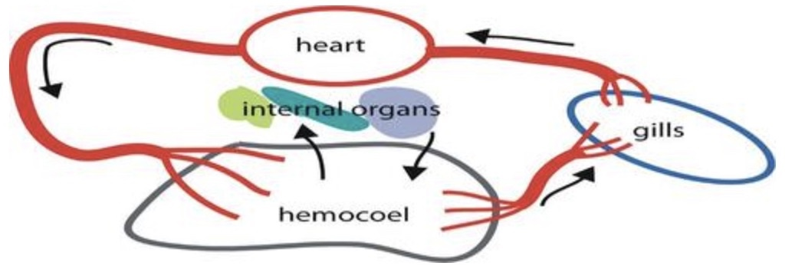
Phylum Mollusca: Circulation
https://www.carlsonstockart.com/photo/mollusk-clam-anatomy-structure-illustration/
Notes:
This group of animals uses a heart to pump blood through the animal via an open circulatory system. Here the blood is not contained entirely in enclosed blood vessels like we see in vertebrates. The heart pumps blood through blood vessels that go from the gills into cavities of the body called hemocoels. A hemocoel is a blood filled cavity that is often distinct from the fluid filled coelom. As soon as the blood reaches the hemocoel its no longer contained in the vessels which allows it to diffuse to the rest of the body tissues. The blood then re-enters via vessels to head back to the gills where C02 is sent to the water in the mantle cavity. In our faster moving organisms like the cephalopods this system is inefficient and thus they have a closed circulatory system in order to allow for that additional energy need. For the purposes of this lab, and your dissection lab, we will not be focusing on cephalopods.

Slide 15
Phylum Mollusca: Excretion
Copyright Pearson Prentice Hall
Notes:
The main organ involved in the excretory system of Mollusca are tubular organs called nephridia. These structures are involved in filtering the waste from the fluid found within the body cavity. These small tubes open up into the coelom and have tiny cilia that surround the tube opening (we saw something similar to this earlier in our earthworm friend) which cause fluid to flow from the coelom into the tubules. Once the fluid enters the nutrients we want to keep then get reabsorbed into the animals body. The leftovers are excreted out of the nephridia exit pores in the mantle cavity. Essentially the nephridia are like very very simple kidneys.

Slide 16
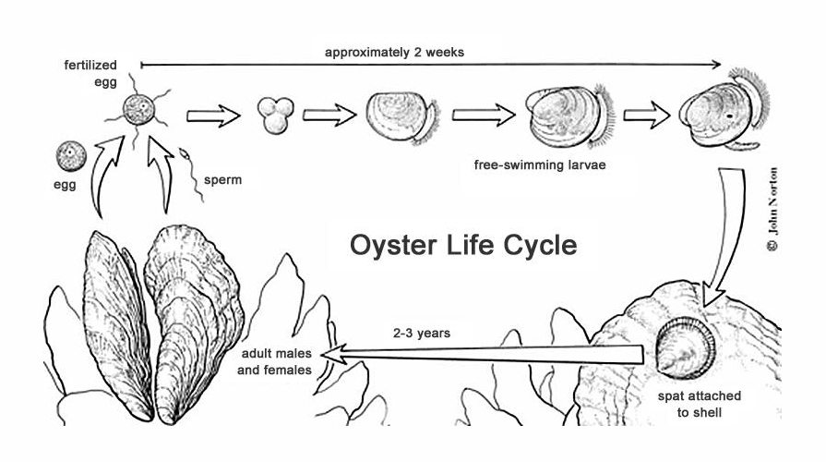
Phylum Mollusca: Reproduction
https://learn.weatherstem.com/modules/learn/lessons/124/11.html
Notes:
Okay how do these guys make babies? Most species have separate sexes and thus facilitate sexual reproduction. Typically they release both eggs and sperm via the excurrent siphon into the water at the same time for external fertilization. For land mollusca (snails basically) they do things a bit differently in that they are hermaphroditic and thus make both gametes and facilitate internal fertilization. The developmental stages seen in this slide are pretty similar for most mollusca. Following fertilization the fertilized egg develop into two stages of larvae with the second stage settling on the floor bottom where metamorphosis will occur creating the adult form which will secrete the shell.

Slide 17
Phylum Mollusca: Summary
Unidirectional Respiration – Ctenidia for Gas Exchange
Complete Digestive System - Radula
Excretion - Nephridium
Open Circulatory System – Hemocoel/Gills/Heart

Slide 18
Let’s now look at the largest phylum we will be looking at! Welcome to Arthropods
Notes:
This is the largest phylum which include animals such as insects, arachnids and crustaceans. The very word “arthropoda” means jointed leg which is the major characteristic these animals have that put them in this phyla. The characteristics of this phylum include segmented bodies, segmented appendages and an exoskeleton. Did you know there are more types of beetles in the world than any other type of animal?

Slide 19
Phylum Arthropoda: Digestion
Foregut
Midgut
Hindgut
http://www.biologyjunction.com/grasshopper_internal.htm
Notes:
These guys don’t eat too much differently than we do. They have appendages near their mouth which helps them move food into their body. Arthropods can be carnivores, herbivores, detritus feeders, filter feeders, and parasites with mouth parts being specialized depending on which category of feeding the animal follows. Most often the paired appendages surrounding the mouth are designed for food collection and handling. Part of the digestive tract includes a foregut and hindgut which are lined with the same skeletal material found on the outside of the body. The midgut is lacking this chitinous lining. The digestive tract can vary significantly based on the diet and feeding of the organism however, in general, the midgut is the region of most digestive enzymatic production and absorption of digested food. Digestion is primarily extracellular and similar to mammals in that the food is moved via muscular contraction. This group has a complete digestive tract which includes; the foregut with an esophagus, crop and gizzard and the midgut, composed of the gastric caeca and stomach. The hindgut is composed of Ileum, colon, rectum and anus.

Slide 20
Phylum Arthropoda : Respiration
Tracheae throughout body = vertebrate circulation
No ability to move oxygen via pigments ≠ earthworm
Spiracles open and close to control air entry and water loss. Hmmm what non animal does this sound like? Hint. Stomata?
https://www.britannica.com/animal/insect/Circulatory-system
Notes:
Arthropods have a variety of respiratory systems including the tracheal system, book-lungs and gills depending on the organism you are looking at. For the purposes of our lab we will be looking at the grasshopper and so we will focus on the tracheal system. Insects typically use this system for respiration. It consists of elastic air tubes called tracheae. The tracheae can be found distributed all throughout the body similar to the circulatory system of vertebrates (keep this in mind when looking at the rat in a few labs), consequently the air is in constant contact with the cells and tissues of the body. So unlike our earthworm these guys do not have the ability to move oxygen via pigments and so have a poor capacity for oxygen transport. As part of the tracheal system there are spiracles, which is the area where air can move into the body. There are typically 10 spiracles with 2 on the thoracic section of the body and 8 on the abdominal section. The branches within the tracheae are called tracheoles and in some insects the tracheae will open into air sacs.

Slide 21
Phylum Arthropoda: Circulation
Heart to hemocoel back to heart via ostia (pores)
An open circulatory system is where blood is pumped, via heart, into hemolymph which surrounds the organs (Arthropods) while a closed circulatory system the blood stays within vessels (Annelids)
Notes:
As we mentioned before, arthropods have an open circulatory system which includes a dorsal heart and a system of arteries that vary significantly in how extensive they are depending on the animal. The arteries deliver the blood into the hemocoel where it drains back into a large pericardial sinus surrounding the heart. In the closed circulatory system, like that of the earthworm, we have multiple hearts functioning in the same way as the heart we see here but instead of draining into the surrounding fluid (the hemolymph) it moves via blood vessels so the blood remains contained. Multiple contractile vessels (hearts) are often present in insects

Slide 22
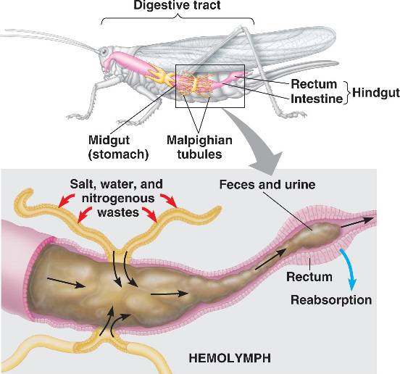
Phylum Arthropoda : Excretion
Malpighian Tubules!
Malpighian Tubules!
Malpighian Tubules!
We made it to land thanks to Malpighian Tubules.
Okay you guys should really remember these now ☺.
http://bio1152.nicerweb.com/Locked/media/ch44/malpighian.html
Notes:
Malpighian tubules! If you are going to remember anything about this slide remember Malpighian tubules. These are essentially like the kidney’s in vertebrates. They are projections of the digestive tract that help conserve water which is hugely important as an adaption for surviving in terrestrial environments. We see this very adaptation in the grasshopper organism which we will be working with this lab and in your next dissection lab. These tubules are free floating in the hemolymph and they absorb nitrogenous waste via diffusion. The waste is transported through the lumen of the tubules and sent to the rectum. Any additional water or solutes are pumped back across the rectal wall. Malpighian tubules are generally located in the posterior regions of the arthropod bathed in hemolymph.

Slide 23
Phylum Arthropoda : Reproduction
Yup the life cycle is pretty much that simple. Hatch and grow!
This won’t take long and then I’m out of here!
So not fair! He spends his adulthood doing whatever he wants while I have to go find some soft soil after this, and deposit these eggs one bundle at a time over the next 4 days.
All these smaller versions are just called Nymphs.
https://www.pinterest.ca/pin/407505466260084491/
Notes:
For the purposes of simplicity we will be focusing on grasshopper reproduction but other arthropods will follow a similar life cycle. In reproduction of grasshoppers you have a female and a male who will mate, usually in early autumn. The male’s reproductive organs include a pair of testes, which contain the spermatocyte cells giving rise to the sperm cells, and a structure called the aedeagus. The aedeagus is the structure that will be used to insert the sperm package (spermatophore) into the female during mating. The female grasshopper has the egg containing ovaries and an ovipositor. When love is in the air the male grasshopper inserts his aedeagus into the females ovipositor and deposits the spermatophore. This “gift” will then be used to fertilize the eggs through tiny passages called micropyles. The males will fertilize the females who will then do all the work of laying the eggs for next summer’s grasshopper population (what else is new lol). So fertilization is internal compared to the Mollusca group we talked about earlier The female deposits the eggs via an elongated abdomen into the ground. Grasshopper spend 1 month of their 1 year as an adult while the rest of their time they are in juvenile stages (so basically they get to stay as a kid most of their life). Upon hatching they are in the nymph stage where they look like tiny grasshoppers but are a bit lighter in colour and they will continue molting until they reach adult stage.

Slide 24
Phylum Arthropoda : Summary
Reproduction – Quick and not really much different than us?
Yikes so much to remember! You can do it just don’t wait till just before your presentations right???
Respiration – One-way flow - spiracles
Complete Digestion
Excretion – Malpighian Tubules Remember!
Open Circulatory System like our friend the clam!

